Slide 1
By
DR BALAMURUGAN T
Senior resident
Department of cardiology
kozhikode MCH
BP MEASUREMENTS

Slide 2
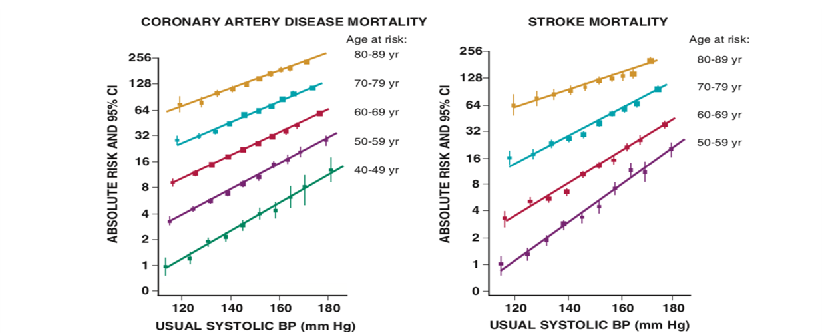
DEFINITION
Hypertension is defined as office systolic blood pressure (SBP) of 140mmHg or greater, diastolic blood pressure(DBP) of 90 mmHg or greater
Lewington s et al ,Age specific relevance of BP to vascular mortality; a meta analysis of individual data for on million adults in 61 prospective studies, lancet 2002;360:1903)

Slide 3
INTRODUCTION
The number one risk factor for global disease burden 2010
Most common, readily identifiable, reversible risk factor for
Myocardial infarction
Stroke
Heart failure
Atrial fibrillation
Aortic dissection
Peripheral arterial disease
WHO (2015)

Slide 4
INTRODUCTION
Control of BP significantly ↓ cardiovascular complications
10/5 mmHg reduction in BP | Average reduction in events (%)
All major CV events | 20 %
All cause- mortality | 10-15%
Stroke | 35%
Coronary events | 20%
Heart failure | 40 %
CV - cardiovascular

Slide 5
JNC 7 - CLASSIFICATION
STAGE | Systolic BP(mmHg) | Diastolic BP(mmHg)
Normal | <120 | <80
Pre-hypertensive | 120-139 | 80-89
Grade 1 HTN | 140-159 | 90-99
Grade 2 HTN | >160 | >100
Of 2 or more readings taken at each of 2 or more visits after initial screening

Slide 6
ACC/AHA 2017 CLASSIFICATION
 | Systolic BP (mmHg) | Diastolic BP (mmHg)
Normal BP | <120 | <80
Elevated BP | 120-129 | <80
Hypertension
Stage 1 | 130-139 | 80-89
Stage 2 | ≥ 140 | ≥ 90
Isolated systolic HTN | ≥130 | <80
Isolated diastolic HTN | <130 | ≥80
(Based on an average of ≥ 2 careful readings obtained on ≥ 2 occasions)

Slide 7
European Society of Hypertension (2018)
Category | Systolic BP (mmHg) | Diastolic BP (mmHg)
Optimal | <120 | <80
Normal | 120-129 | 80-84
High Normal | 130-139 | 85-89
Grade 1 HTN | 140-159 | 90-99
Grade 2 HTN | 160-179 | 100-109
Grade 3 HTN | ≥180 | ≥110
Isolated systolic HTN | ≥140 | <90

Slide 8
EPIDEMIOLOGY: GLOBAL STATISTICS
1.13 billion people world wide
7.5 million deaths (~ 12.8% of the total deaths)
57million DALYS or 3.7% of total DALYS
Global prevalence of raised BP in adults ≥18 years (2015) :
Overall - 22.1%
Males - 24% Females - 20%
DALYS-Disability adjusted life years

Slide 9
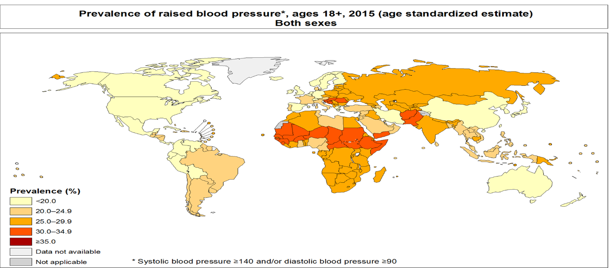
EPIDEMIOLOGY: GLOBAL STATISTICS
 | Prevalence of HTN
Global HTN prevalence | 22.1 %
WHO regions
Africa | 27.4 %
America | 17.6 %
South east Asia | 25.1 %
Europe | 23.2 %
Eastern Mediterranean | 26.3 %
Western pacific | 19.2 %
World health organization-2015
www.WHO.int/gho/ncd/risk_factors/blood_pressure

Slide 10
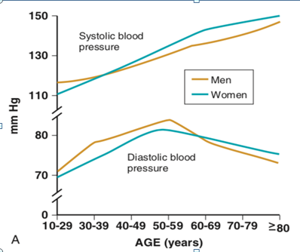
INTRODUCTION
>60 years of age : Prevalence of HTN > 60 %

Slide 11
EPIDEMIOLOGY:INDIAN STATISTICS
Overall prevalence of hypertension in India is 29.8 %
142 articles (of 3047) | RURAL | URBAN
Prevalence of hypertension | 27.6% | 33.8%
Of these, aware of HTN status | 25% | 42%
Being treated | 25% | 38%
Control of BP | 10.7%(1/10) | 20.2%(1/5)
Raghupathy Anchala et al,Hypertension in India; a systematic review and meta analysis of prevalence , awareness and control of hypertension
www.jhypertension.com June 2014

Slide 12
BP MEASUREMENT

Slide 13
HISTORY - THE PATH BARKING CONCEPT

Slide 14
NON INVASIVE METHODS

Slide 16
Types of Sphygmomanometers
MERCURY SPHYGMOMANOMETERS
ANEROID SPHYGMOMANOMETERS
HYBRID SPHYGMOMANOMETERS
OSCILLOMETRIC SPHYGMOMANOMETERS

Slide 17
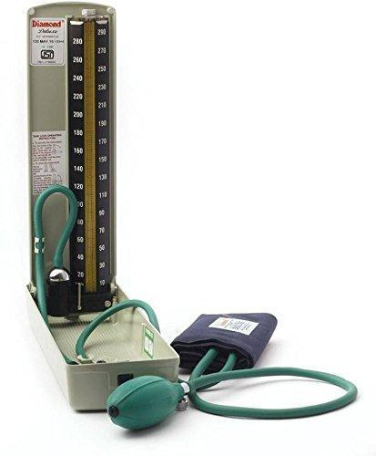
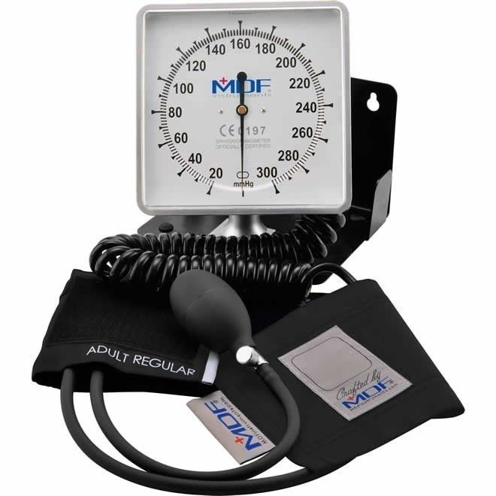

Slide 18
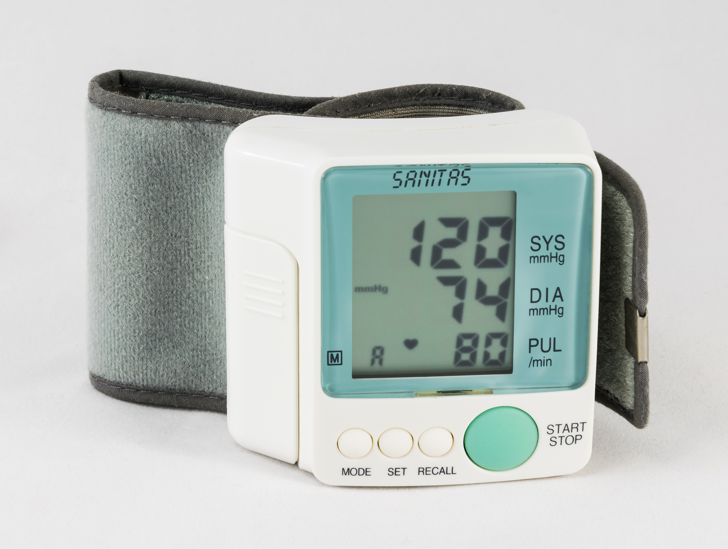
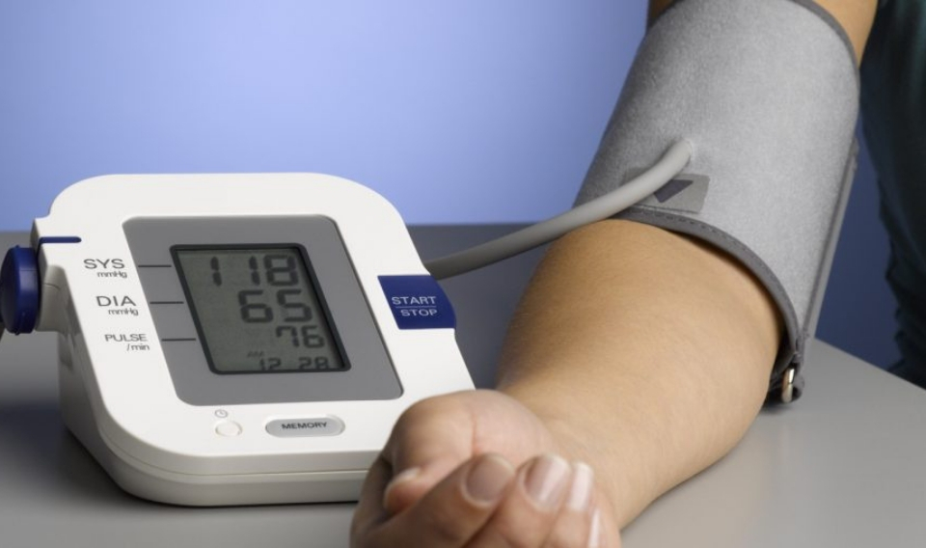

Slide 19
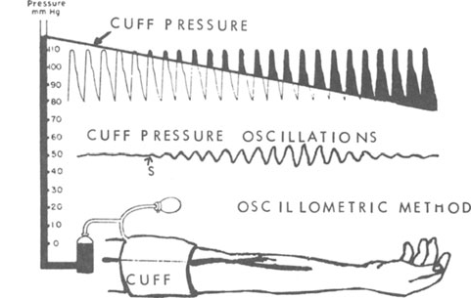
The Oscillometric Technique
Based on the amplitude of the oscillations recorded in the lateral walls of the upper arm.
Most oscillometric devices estimate BP when the cuff is being deflated, but some devices obtain estimates on inflation.
Mean arterial BP is estimated to be the cuff pressure when the oscillation amplitude is maximal, and then the SBP and DBP are computed.

Slide 20
ADV & DIS
No transducer need to be placed over the brachial artery.
Less susceptible to external noise (but not to low frequency mechanical vibration).
Main disadvantage is that such recorders do not work well during physical activity when there may be considerable movement artifact

Slide 21
Special BP Measurement Techniques

Slide 22
Ultrasound techniques
This technique use an ultrasound transmitter and receiver placed over the brachial artery under a sphygmomanometer cuff.
As the cuff is deflated, the movement of the arterial wall at systolic pressure causes a Doppler phase shift in the reflected ultrasound, and diastolic pressure is recorded as the point at which diminution of arterial motion occurs.
Patients with very faint Korotkoff sounds placing a Doppler probe over the brachial artery detects the systolic pressure
Same technique used for measuring the ankle-brachial index

Slide 24
The finger cuff method of Penaz
Principle - “unloaded arterial wall.”
Arterial pulsation in a finger is detected by a photo-plethysmograph under a pressure cuff.
The output of the plethysmograph is used to drive a servo-loop, which rapidly changes the cuff pressure to keep the output constant, so that the artery is held in a partially opened state.
The oscillations of pressure in the cuff are measured and have been found to resemble the intra-arterial pressure wave in most subjects.
Accurate estimate of the changes of systolic and diastolic pressure when compared to brachial artery pressures,
Commercially available as the Finometer and Portapres recorders.

Slide 26
Wrist Monitors
Wrist monitors have become popular- ease of use and in obese
Limitations –
Measured only if the sensor is directly over the radial artery
Accurate reading only if the wrist is at heart level

Slide 27
Tonometry
Applanation tonometry provides a noninvasive, reproducible, and accurate representation of the aortic pressure waveform and an assessment of the central pulse pressure waveform.
Radial artery applanation tonometry performed by placing a handheld tonometer (strain-gauge pressure sensor) over the radial artery
The radial artery pressure transmitted from the vessel to the sensor and is recorded digitally.
.

Slide 28
A mathematical formula using Fourier analysis permits calculation of central pressure indexes from a peripheral brachial BP and concomitant recording of a pulse pressure wave.
SBP and DBP estimated from the shape of the waveform.
Major drawback operator dependent, requires trained technician and calibration of peripheral BP recordings, and cumbersome in clinical practice

Slide 29
Smartphone Technology
Mobile health technologies may potentially be an effective means of providing health information, support, and management strategies to promote hypertension self-management.
Apps have been developed to measure BP – requires validation
To date, mobile health BP monitors - poor accuracy compared with oscillometric readings.

Slide 30
Wearable Sensors and Cuffless BP Monitors
New trend in the development of wearable devices that can promote a healthy lifestyle
One wrist-based method estimates BP from the pulse transit time
Device can also monitor heart rate using an ECG and can measure blood oxygenation
This uses Bluetooth for wireless transmission of BP.

Slide 31
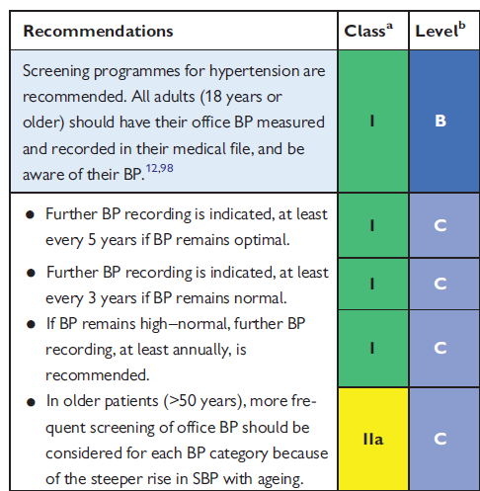
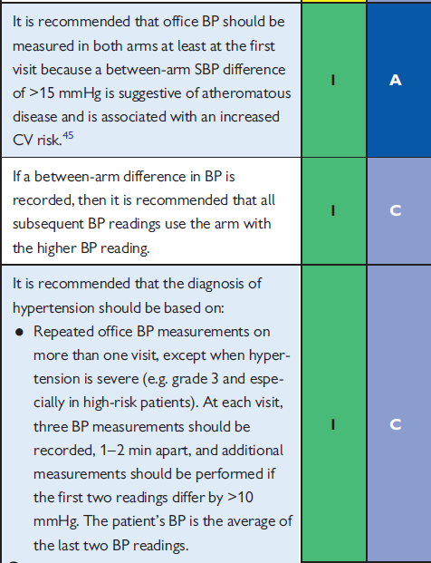
RECOMMENDATION OF BP MEASUREMENTS

Slide 33
METHODS OF BP MEASUREMENT
4 Approaches to BP measurement
Conventional office BP
Automated office BP (unattended)
Home monitoring (HBPM)
Ambulatory BP monitoring (ABPM)
Gold standard

Slide 34
Conventional office BP
PALPATORY METHOD
AUSCULTATORY METHOD

Slide 35
STEPS IN BP MEASUREMENTS

Slide 37
CHECKLIST FOR ACCURATE MEASUREMENT OF BP
Key Steps for Proper BP Measurements
Step 1: Properly prepare the patient
Step 2: Use proper technique for BP measurements
Step 3: Take the proper measurements needed for diagnosis and treatment of elevated BP/hypertension
Step 4: Properly document accurate BP readings.
Step 5: Average the readings.
Step 6: Provide BP readings to patient
Other points to remember
SBP by palpatory method
Inflate cuff 20 to 30 mmHg above this level
Deflate cuff @
2 mmHg /sec

Slide 42
AUTOMATED OFFICE BLOOD PRESSURE(AOBP)
Oscillometric monitor - unattended for 5 mins
3 readings at 1 min interval with single activation.
It is preferred over conventional office BP
Minimizes white coat reaction
Correlates better with home or awake ambulatory BP
AOBP is 15/10 mmHg lower than conventional office BP
HTN if AOBP ≥ 135/85 mmHg

Slide 46
HOME BASED BLOOD PRESSURE MONITORING (HBPM)
Procedure : after 5 mins of rest , two readings 1min apart each in the morning
and evening for 3 consecutive days ( ideal 7 days)
First day’s readings discarded
All other readings are averaged
HTN- if HBPM ≥ 135/85 mmHg
HBPM improves medication adherence by involving patients in their own medical care.
HBPM also can be used to identify patients with white-coat hypertension and masked hypertension.

Slide 47
HBPM Devices and Device Selection
Oscillometric - preferred measurement method.
Some devices can be programmed to take multiple readings with the option of specifying the interval between readings (eg, 1 or 2 minutes).
Only devices that can store readings, along with the dates/times they were taken, that can be displayed on the device screen, printed, or transmitted to their healthcare provider should be recommended to patients.
Some devices can detect the presence of atrial fibrillation

Slide 48
Clinical Indications for the Use of HBPM
Assessing for the presence of white-coat hypertension or masked hypertension
Monitoring of antihypertensive medication efficacy in treated patients
– Assessing for white-coat effect
– Assessing for masked uncontrolled hypertension

Slide 49
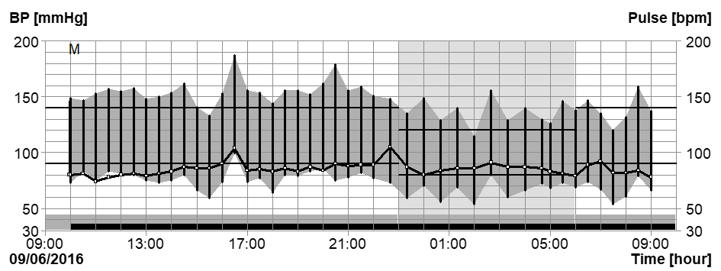
AMBULATORY BLOOD PRESSURE MONITORING (ABPM)
ABPM is the gold standard
BP- 24hr or 48 hr (better) period while engaged in usual activities
including sleep
Measurements at 15-30 mins interval , average of at least 14
HTN- Average daytime BP ≥ 135/85 mmHg
Average night time BP ≥120/70 mmHg
Average 24 hr BP ≥130/80 mmHg

Slide 51
BP VARIABILITY
BP normally fluctuates during the day and varies from day-to-day.
Pronounced fluctuations in BP can occur over short/ long-term.
Episodic Hypertension is common:
In TIA patients, 12% had stable HT, 69% had episodic HT (some SBP readings ≤140 mmHg, some >140mmHg)
BPV is difficult to measure in routine clinical practice: no clearly defined or widely adopted diagnostic definitions or treatment goals.

Slide 52
BP REACTIVITY
Defined as the response to environmental stressors
Usually quantitated as responses to standardized laboratory stressors.
Hot reactors –individuals with increased reactivity.
Difficult to quantitate – reactivity differs from stressor to stressor and even upon retesting with same stressor.
Suspected to be predictive of future development of hypertension and CV risk – studies have not found this to be true.

Slide 53
BP LABILITY
Characteristic of human BP
No clear definition that differentiates normal from abnormal lability.
Labile hypertension – widely used – lacks an accepted definition and is more of a clinical impression rather than a specific diagnosis.
Patients experience transient but substantial increases in BP.
Likely due to sympathetic activation.
BP usually falls without intervention.
Risk of hypertension in future but no role of pre treatment.

Slide 54
TYPES OF BP VARIABILITY DETERMINANTS AND PROGNOSTIC RELEVANCE

Slide 55
BPV DIFFERS IN EXTENT BETWEEN INDIVIDUALS

Slide 56
FACTORS ASSOCIATED WITH BPV

Slide 57
Any clinical measurement of blood pressure may be regarded as a surrogate measure for the “TRUE” blood pressure of the patient, which may be defined as the mean level over prolonged periods.
Two techniques developed to improve the estimate of true blood pressure — ambulatory monitoring and home monitoring (or self monitoring).

Slide 58
Ambulatory blood
pressure (ABP)
monitoring involves
measuring blood pressure
(BP) at regular intervals
(usually every 15–30
minutes) over a 24 hour
period while patients
undergo normal daily
activities, including sleep.

Slide 60
The portable monitor is worn on a belt connected to a standard cuff on the upper arm .
When complete, the device is connected to a computer that prepares a report of the 24 hour, day time, night time, and sleep and awake (if recorded) average systolic and diastolic BP and heart rate.

Slide 61
ABPM – MEASURING METHOD
Uses cuff oscillometry.
Cuff inflated until the pressure occludes flow within the brachial artery.
As the pressure is released, blood begins to flow causing fluctuations(oscillations) in the arterial wall that are detected by the monitor.
These oscillations increase in intensity then diminish and cease when blood is flowing normally.
The monitor defines the maximal oscillations as mean arterial BP and then uses an algorithm to calculate systolic and diastolic BP.

Slide 62
INTERPRETATION OF ABPM
Unique data provided by ABPM include:
24-hour average blood pressure (BP)daytime (awake) BP
Night time (asleep) BP
Systolic blood pressure load
Diastolic blood pressure load
Nocturnal dipping of the BP

Slide 63
Reference ‘normal’ ABP values for non pregnant adults are:
○ 24 hour average <115/75 mmHg (hypertension threshold 130/80 mmHg)
○ Day time (awake) <120/80 mmHg (hypertension threshold 135/85 mmHg)
○ Night time (asleep) <105/65 mmHg (hypertension threshold 120/75 mmHg).

Slide 64
ABPM – DIAGNOSTIC THRESHOLDS

Slide 65
INTERPRETATION OF ABPM
Ambulatory BP values above ‘normal’ and below thresholds for hypertension are considered ‘high normal’.
Night time (sleeping) average systolic and diastolic BP should both be at least 10% lower than day time (awake) average.
Blood pressure load (percentage of time that BP readings exceed hypertension threshold during 24 hours) should be <20%.

Slide 68
BP PATTERNS - OFFICE AND OUT-OF-OFFICE
 | Office/Clinic/Healthcare setting | Home /Non health care/ABPM setting
Normotensive | No Hypertension | No Hypertension
Sustained Hypertension | Hypertension | Hypertension
Masked Hypertension | No Hypertension | Hypertension
White coat Hypertension | Hypertension | No Hypertension
ABPM- Ambulatory BP Monitoring
Hypertension and journal of the American college of cardiology
www.acc.org

Slide 69
WHITE COAT HYPERTENSION
Clinic blood pressure of 140/90 mm Hg or higher on at least three occasions, with at least two sets of measurements of less than 140/90 mm Hg in nonclinic settings, plus the absence of target-organ damage.

Slide 70
ANXIETY- MAIN CAUSE
Having the BP in the office taken by a nurse or technician, rather than the clinician, may minimize the white coat effect.
In patients diagnosed as being hypertensive on a first visit to a new clinician, there is a mean 15 and 7 mmHg fall in the systolic and diastolic BP, respectively, by the third visit , with some patients not reaching a stable value until the sixth visit .
Recommended that a patient with mild to moderate elevation in BP should not be diagnosed with hypertension unless the BP remains elevated after three to six visits, unless there is evidence of ongoing end organ damage

Slide 71
PROGNOSIS OF WHITE COAT HYPERTENSION
The cardiovascular risk associated with white coat hypertension slightly higher compared with persistent normotension but well below the risks associated with either masked or sustained hypertension.
Population-based cohort of 2051 adults who underwent office, home, and ambulatory blood pressure measurements, those with white coat hypertension had a significantly higher rate of all-cause mortality during 16 years of follow-up as compared with persistent normotension (19.7 versus 6.4 percent).
Patients with white coat hypertension are also at high risk for developing sustained hypertension.

Slide 72
MASKED HYPERTENSION
Defined as a normal clinic blood pressure and a high ambulatory blood pressure
Reverse of white-coat hypertension.
The clinic blood pressure of patients with masked hypertension may underestimate the risk of cardiovascular events.
As many as 10 to 40 percent of patients who are normotensive by conventional clinic measurement are hypertensive by ABPM.
This phenomenon is called masked hypertension or isolated ambulatory hypertension.

Slide 73
Associated with increased long-term risk of sustained hypertension and cardiovascular morbidity
Because of the risk associated with masked hypertension, ambulatory blood pressure monitoring should be considered in patients referred for possible hypertension.

Slide 74
Masked uncontrolled hypertension
Treated subjects with office blood pressure <140/90 and
24-h ABPM ≥130/80 mmHg and/or
Awake ABPM ≥135/85 mmHg and/or
Sleep ≥120/70 mmHg or
Home blood pressure ≥135/85 mmHg

Slide 75
BP LOAD
Defined as percentage of ambulatory systolic and diastolic pressures exceeding 140 mmHg and 90 mmHg during the daytime, and 120 mmHg and 80 mmHg during sleep.
The overall BP load - determinant of cardiovascular risk.
BP load is 40 percent or more in untreated hypertensive subjects – CV risk

Slide 76
NOCTURNAL BLOOD PRESSURE AND NONDIPPERS
The average nocturnal BP is approximately 15 percent lower than daytime values in both normals and hypertensive patients.
Failure of the BP to fall by at least 10 percent during sleep is called nondipping.
The underlying mechanisms of nondipping are unknown, but intrinsic renal defects may contribute, also some evidence suggesting that melatonin plays a role.
Independent of the degree of hypertension, nondipping is a risk factor for the development of left ventricular hypertrophy (LVH), heart failure and other cardiovascular complications .

Slide 77
Nondipping associated with microalbuminuria and faster progression of nephropathy in patients with diabetes mellitus.
Nondipping risk factor for decline in glomerular filtration rate, and ESRD and death among patients with chronic kidney disease.
The presence of sleep apnea should also be considered in nondippers.
Extreme "dipping" (eg, >20 percent nocturnal decline in BP) and a large morning increase in BP are also potentially deleterious

Slide 78
Non Dippers commenly seen in
Sleep Disturbance
OSA
Obesity
High Salt Intake
Autonomic Dysfunction
CKD
Diabetic Neuropathy
Old Age

Slide 79
Normally BP ↓ses by 10-20% at night (Dipping)
Range of BP Dipping | CLASS
<0% | Reverse Dipping
0 to 10% | NON –Dipping
10 to 20% | Dipping (normal)
>20% | Extreme dipping

Slide 80
Morning BP Surge
CVD events, including myocardial infarction and stroke, frequently occur during the period between 6 am and noon.
Coincides with the rapid rise in BP that occurs when people awaken- hypothesis that the rise in BP on awakening is associated with increased CVD risk.
The morning BP surge has been defined as the difference between the average BP during the 2 hours after awakening and either the mean during the 2 hours before awakening or the mean of the lowest nighttime BP and the 2 readings surrounding the lowest reading.

Slide 85
INVASIVE ARTERIAL PRESSURE MONITORING
Intra-arterial blood pressure (IBP) measurement gold standard of blood pressure measurement.
Despite its increased risk, cost, and need for technical expertise for placement and management, its utility in providing crucial and timely information outweighs its risks in many cases

Slide 86
Indications for Arterial Cannulation
Continuous, real-time blood pressure monitoring
Planned pharmacologic or mechanical cardiovascular manipulation
Repeated blood sampling
Failure of indirect arterial blood pressure measurement, e.g. burns or
obesity
Supplementary diagnostic information from the arterial waveform

Slide 87
BASIC PRICIPLES
The pressure waveform of the arterial pulse is transmitted via the column of fluid, to a pressure transducer where it is converted into an electrical signal.
This electrical signal is then processed, amplified and converted into a visual display by a microprocessor.

Slide 88
Percutaneous Radial Artery Cannulation

Slide 89
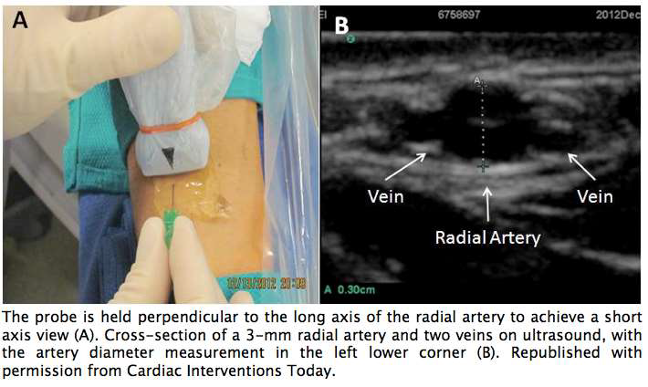
ULTRASOUND IMAGING

Slide 90
Alternative Arterial Pressure Monitoring Sites
• Ulnar
• Brachial
• Axillary
• Femoral – seldinger technique
• Dorsalis pedis

Slide 91
Complications of Direct Arterial Pressure Monitoring
• Hemorrhage
• Misinterpretation of data
• Distal ischemia
• Pseudoaneurysm
• Arteriovenous fistula
• Arterial embolization
• Infection
• Peripheral neuropathy

Slide 93
CARE
Aseptic precautions
Daily inspection & dressing
Pressure bag
Transducer to be changed every 72 hours
Arterial line to be changed/removed after 1 week
Joint near the cannulation site: neutral position
Prompt removal if signs of ischemia

Slide 94
COMPONENTS OF AN IABP MEASURING SYSTEM
Intra-arterial cannula
Fluid filled tubing
Transducer
Infusion/flushing system
Signal processor, amplifier and display

Slide 96
Normal Arterial Pressure Waveforms
Systolic waveform components consist of a steep pressure upstroke, peak, and ensuing decline, and immediately follow the ECG R wave.
Downslope of the arterial pressure waveform is interrupted by the dicrotic notch, continues its decline during diastole after the ECG Twave, and reaches its nadir at end-diastole

Slide 98
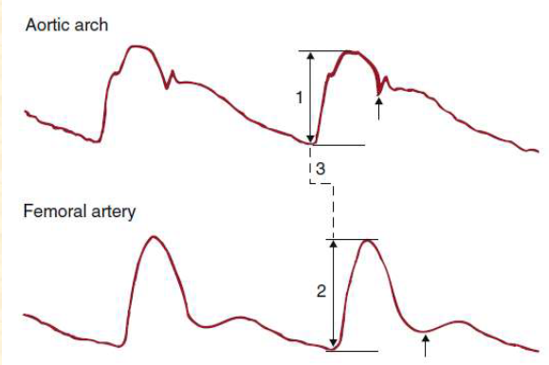
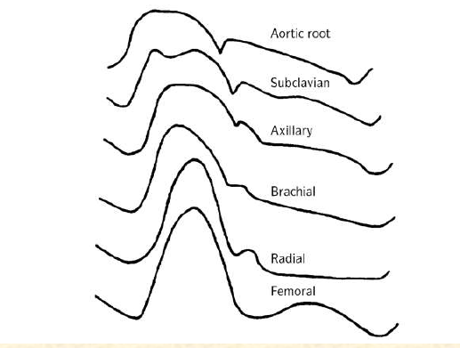
As the pressure wave travels from the central aorta to the periphery, the arterial upstroke becomes steeper, the systolic peak increases, the dicrotic notch appears later, the diastolic wave becomes more prominent, and end-diastolic pressure decreases.

Slide 100
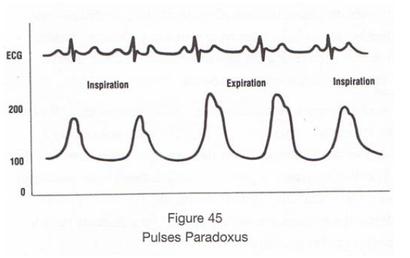
Pulsus alternans- Alteration of weak
and strong beats with no change in
rate- Left Ventricular dysfunction
Pulsus paradoxus- Large
decrease in SBP and pulse
waveform during inspiration.
– Tamponade, severe lung
disease, advanced CHF

Slide 101
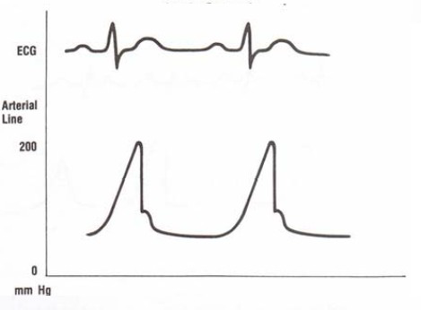
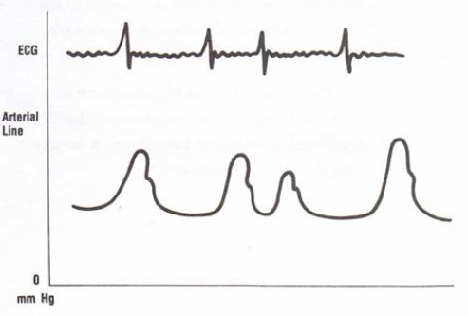
Aortic Stenosis- Dicrotic notch not
well defined from abnormal closure
of leaflet. Narrow pulse pressure
Aortic Insufficiency- Wide pulse
pressure. High blood volume. High
peak systolic pressure during
further systoles.
Atrial Fibrillation- Irregular. Shorter
diastolic filling time. Decreasing
systolic peak amplitude during
premature ventricular complexes.

Slide 102
Measurement of blood pressure in special populations and circumstances

Slide 103
Infants and children
The Korotkoff sound technique is recommended as the standard for children older than the age of 1 year; it may give systematic errors in infants, in whom the sounds are difficult to hear, and thus the true systolic pressure may be underestimated.
In infants the best indirect measurement technique is an ultrasonic flow detector.
A particular problem associated with blood pressure measurement in children of different ages is knowing which sized cuff to choose.

Slide 104
The BHS recommends choosing from three cuff sizes—4×13 cm, 8×18cm, and 12×35 cm (adult cuff)—and putting on the widest cuff that will fit the arm.
The American Heart Association,64 and the National High Blood Pressure Education Program(NHBPEP),have recommended that the cuff size be standardized to the circumference of the arm.

Slide 105
Pregnant women
In normal pregnancy there is a fall of blood pressure, together with an increase of cardiac output and a large decrease of peripheral resistance.
As a result of this hyperkinetic state , Korotkoff-like sounds occasionally may be heard over the brachial artery without any pressure being applied to the cuff - most probably due to turbulent flow in the artery.

Slide 106
Use of phase 4 has frequently been recommended for registering diastolic pressure in pregnant women, which may be 12 mm Hg higher than phase.
The NHBPEP Working Group report recommends recording both phases 4 and 5 throughout pregnancy.In one study of 85 pregnant women, however, phase 5 never approached zero, and phase 4 could be identified in only half, leading the authors to recommend phase

Slide 107
Elderly patients
Isolated systolic hypertension-attributed to a diminished distensibility of the arteries with increasing age.
Diminished compressibility of the artery by the sphygmomanometer cuff -falsely high readings - pseudohypertension
These patients represent the exception rather than the rule, however, because studies of healthy elderly subjects have not shown any greater discrepancy between direct and indirect measurements of pressure than in younger subjects.

Slide 108
Obese patients
It is well known that the accurate estimation of blood pressure using the auscultatory method requires an appropriate match between cuff size and arm diameter.
In obese subjects the regular adult cuff (12×23 cm) may seriously overestimate blood pressure.
The effect of arm circumference on the cuff method of measuring blood pressure was studied systematically by King.

Slide 109
Exercise
During dynamic exercise the auscultatory method may underestimate systolic pressure by up to l5 mm Hg, whereas during recovery it may be overestimated by 30 mm Hg.
Errors in diastolic pressure are unlikely to be as large, except during the recovery period, when falsely low readings may be recorded.
This is the reason why the American Heart Association recommends taking the fourth phase of the Korotkoff sound after exercise

Slide 110
Pseudohypertension
Pseudohypertension occurs when the arterial media becomes severely rigid from calcific arteriosclerosis and the BP cuff/ bladder has to be at a higher pressure to compress the vessel.
It results in an elevated cuff pressure compared with intra-arterial measurements. The earliest diagnosis of pseudohypertension was by the positive Osler sign: when the brachial or radial artery is still palpable distal to a fully inflated BP cuff.

Slide 111
Patients with pseudohypertension are often overtreated with antihypertensive medication, resulting in postural hypotension and other side effects. Most patients have a brachial artery bruit and triphasic BP readings by Doppler.
Older patients with a concomitant history of atherosclerotic disease, chronic kidney disease, and diabetes mellitus have the highest risk of developing pseudohypertension. An anklebrachial index >1.4 suggests the possible presence of noncompressible arteries.

Slide 112
Pulseless Syndromes
Patients with Takayasu arteritis, giant cell arteritis, or severe atherosclerosis and those on long-term hemodialysis with multiple access procedures in the upper extremities may lack detectable brachial pulse
It may be possible to use an ankle-based BP in the supine position, recognizing that the ankle SBP is usually higher than a simultaneous measurement in the brachial artery as a result of SBP amplification, ≈20 mm Hg.
In special circumstances when the carotid artery pressure is known or thought to be normal, retinal arterial pressures can be measured in patients with pulseless syndromes.

Slide 113
Patients With Left Ventricular Assist Devices
Many patients with heart failure who are awaiting transplantation or are not candidates for transplantation are supported by continuous-flow left ventricular assist devices.
They typically do not produce an appreciable pulse because the arterial flow is continuous rather than pulsatile. So only 1 number is recorded, which is referred to as mean BP.
BP can be measured in these patients with a Doppler detector over the brachial artery recording the pressure at which the flow in the artery disappears and reappears.

Slide 114
THANK YOU

